Slide 1
Detecting Silent speech on AirPods
BoLiang 2020.07.08

Slide 2
Self Introduction
BoLiang, from Peking University, China
Summer Intern from 6.28 to 9.15
Physics major, CS dual degree
Mathematical derivation, signal processing, physical system simulation, hardware construction
Previous projects
HCI: Aerial Imaging and Interaction by Retroreflector
Wireless Network: Visible Light Backscatter Communication

Slide 3
Motivation
Observation on the jaw and cheek can provide many information about expression (expression recognition) and spoken words (for silent speech).
C-Face: Besides cameras on AirPods, we can try other sensors to realize the similar effect. The combination of Mic and Speaker is a low-power and low-cost solution for these tasks.

Slide 4
Feasibility
Facial expression contains the enough information for our possible usage
Silent speech
User recognition
Expression recognition
The combination of Mic and Speaker has the ability to obtain the information
Notes:
When I try to understand its feasibility, I think two factors are important.

Slide 5
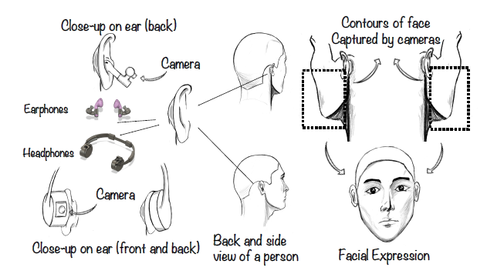
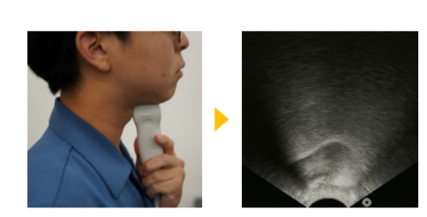
Enough information
C-Face provides us with confidence to try more.
Information for total silent speech may be not enough
The position of tongue and throat is important
SottoVoce: ultrasonic echo probe
A special set of speech commands is more possible
Kimura, N., Kono, M. and Rekimoto, J., 2019, May. SottoVoce: an ultrasound imaging-based silent speech interaction using deep neural networks.

Slide 6
The ability to obtain the information
The resolution of mic with 20kHz is pushed to less than 1cm.
With ultrasound, the accuracy of localization will be higher like 1mm.
The array of Mic can realize beamforming, focusing on a special angle of the sound source.
Beamforming depends on the calculation processing. We can focus on different areas based on one set of data and obtain the positions of the areas we are interested.
Nandakumar, R., Iyer, V., Tan, D. and Gollakota, S., 2016, May. Fingerio: Using active sonar for fine-grained finger tracking.
Nandakumar, R., Iyer, V., Tan, D. and Gollakota, S., 2016, May. Fingerio: Using active sonar for fine-grained finger tracking.

Slide 7
The best Wish
We can just use the frequency of about 20kHz, which is common on the earphone.
Or using ultrasound.
We can recognize lots of tiny changes of the face, thus making the silent speech possible.
Or prescribed set of the commands of expression.

Slide 8
Approach
Frequency Modulated Continuous Waveform (FMCW)
Beamforming on Mic
(Maybe) Beamforming on Speaker

Slide 9
Challenges
Appropriate hardware
High frequency, real-time encoding and real-time feedback
The resolution of beamforming on the face
Rough: can not get enough distinguishable information
Cycle and coding of the active sound signal
Long: challenges on real-time processing
Short: low SNR for FFT and other processing
Notes:
Till to now, I can only find the hardware with good frequency of 400,000Hz. But it only support send pulses. We can not encode the sound wave for high-accuracy positioning.
Insufficient information

Slide 10

Extra function
Soundwave may record more information about the body, such as:
Breath rate
Weak tremor of the whole body ➡ heart rate
Asymmetry of the left and right body ➡ blood pressure
Breath rate is most likely to be achieved. It depends on whether we can find the target position and shoot it with sound waves.
Chest
Sinuses
Notes:
When we breathe, the chest and nose wings will rise and fall, if you can perceive these movements, you have the opportunity to calculate the breathing frequency

Slide 11
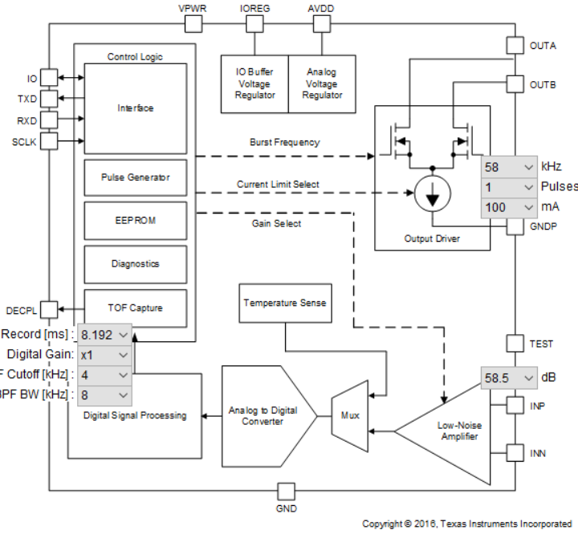
Hardware
PGA460
（30kHz-80kHz,
180kHz-400kHz）

Slide 12
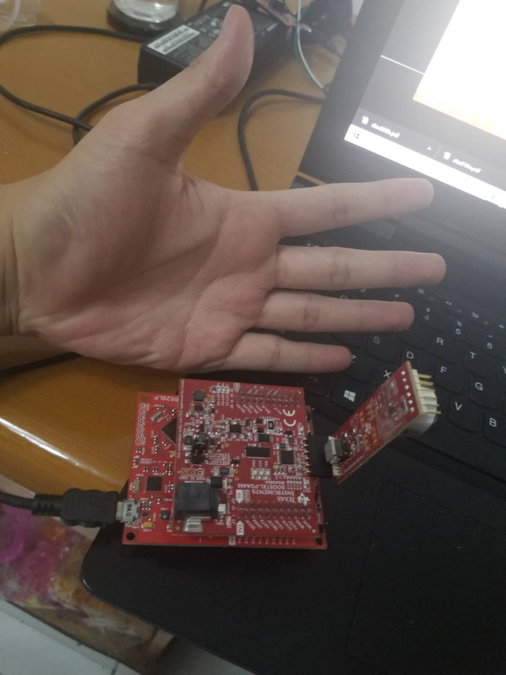
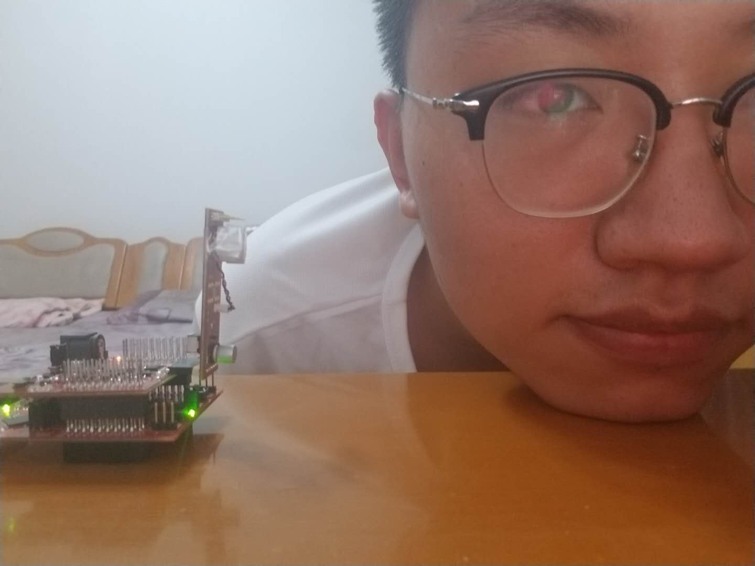
Setup

Slide 13
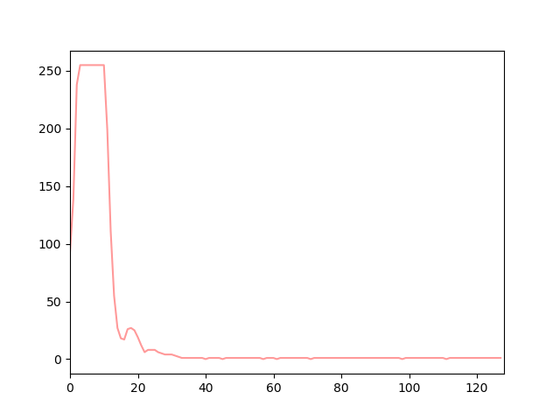
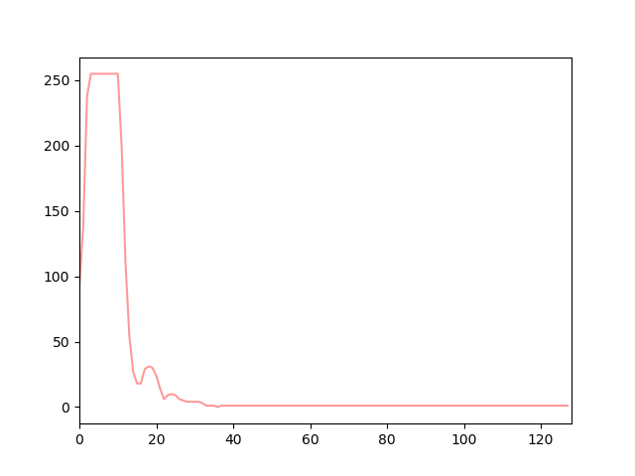

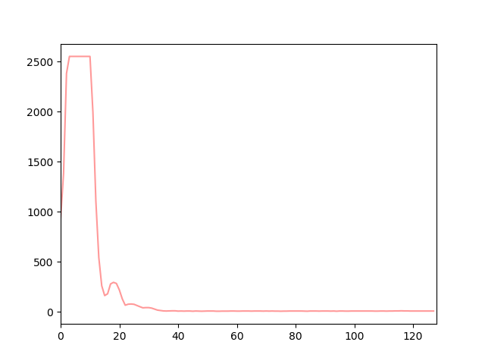
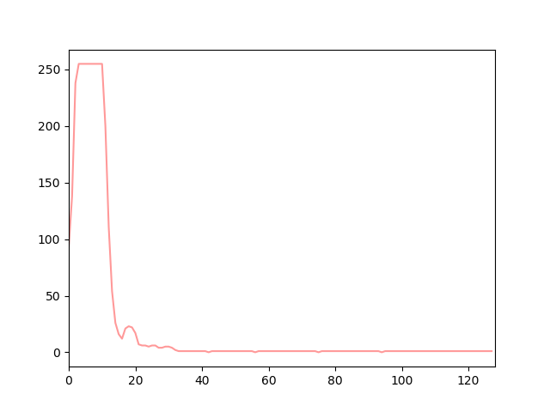


Data: repeatability
The same expression: normal
Average of 10
Record1-6

Slide 14
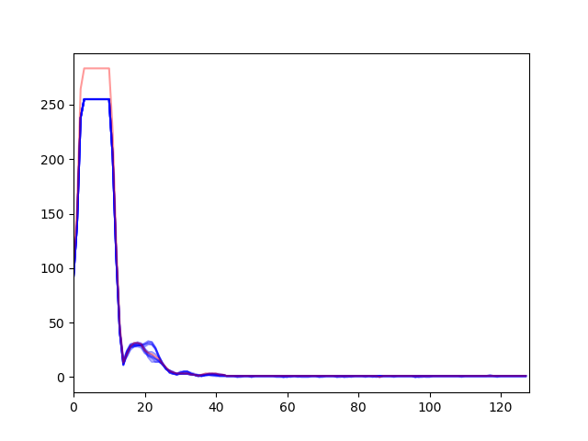
Data: repeatability
Normal
Exp at 18:00
Exp at 22:00

Slide 15
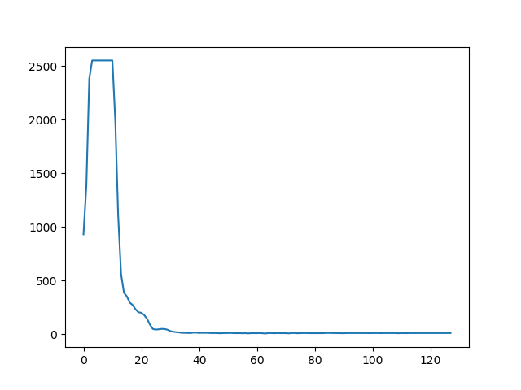
Data: differences
Different expression（Experiment at 18:00）
Normal
Open the mouth

Slide 16
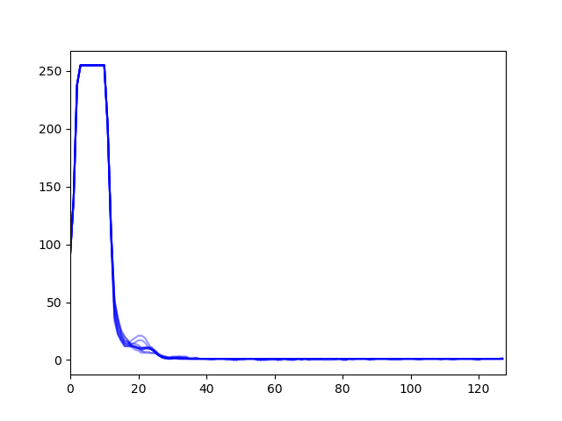
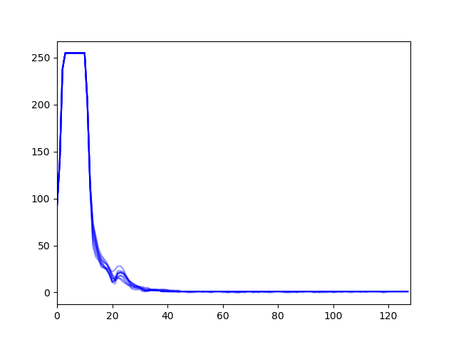
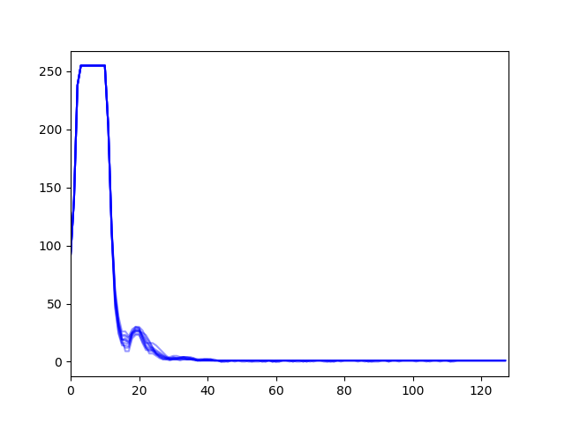
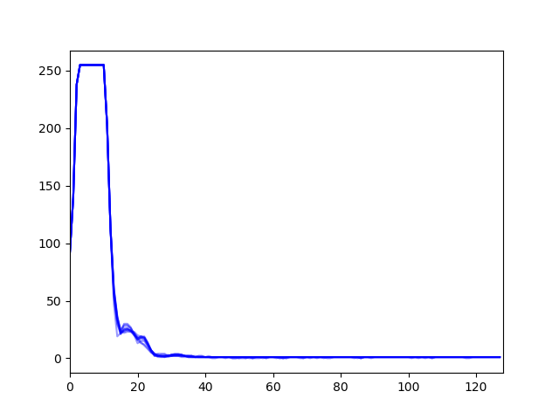
Data: differences
Different expression（Experiment at 22:00）
Normal
Grin
|O:|
Puff checks
Stare

Slide 17
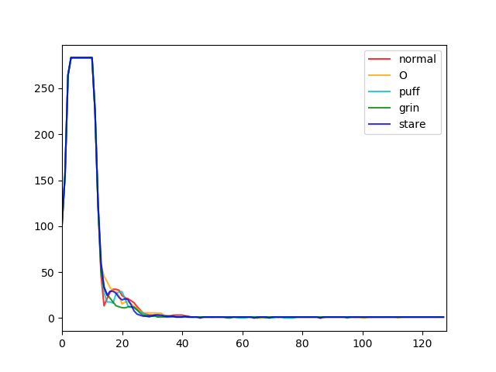





Data: differences

